Slide 1
About this deck….
Hello!
This deck is provided along with a collection of resources to help you host a generative AI themed event that will inform, educate and delight.
Synopsis:
Generative AI isn’t going away! In this talk you will discuss the changing role of the AI Engineer, and how we should all aim to learn some AI Engineering skills in 2024.
This presentation will cover many topics including Foundation Models & Model Selection, Prompting Engineering, Retrieval Augmented Generation (RAG), Agents, Tools and Function Calling and Fine-tuning and Continuation training.
Level: 200-300
(*The level can be adjusted by the presenter to meet the needs of the audience.)

Slide 2
Generative AI in 2024
AI Engineering

Slide 3

What is Generative AI
Image
Text/Chat
> Question: What is generative AI?
Generative AI refers to a type of
artificial intelligence that is capable
of creating new and original content.
It uses algorithms and machine learning
to generate text, images, music, and
other forms of media based on patterns
and rules learned from existing data.
Generated with Amazon Titan Image Generator G1
“A happy golden retriever wearing glasses and a hat in a portrait painting”
Generated with Amazon Titan Text G1 - Express
Notes:
What is Generative AI.

Slide 4
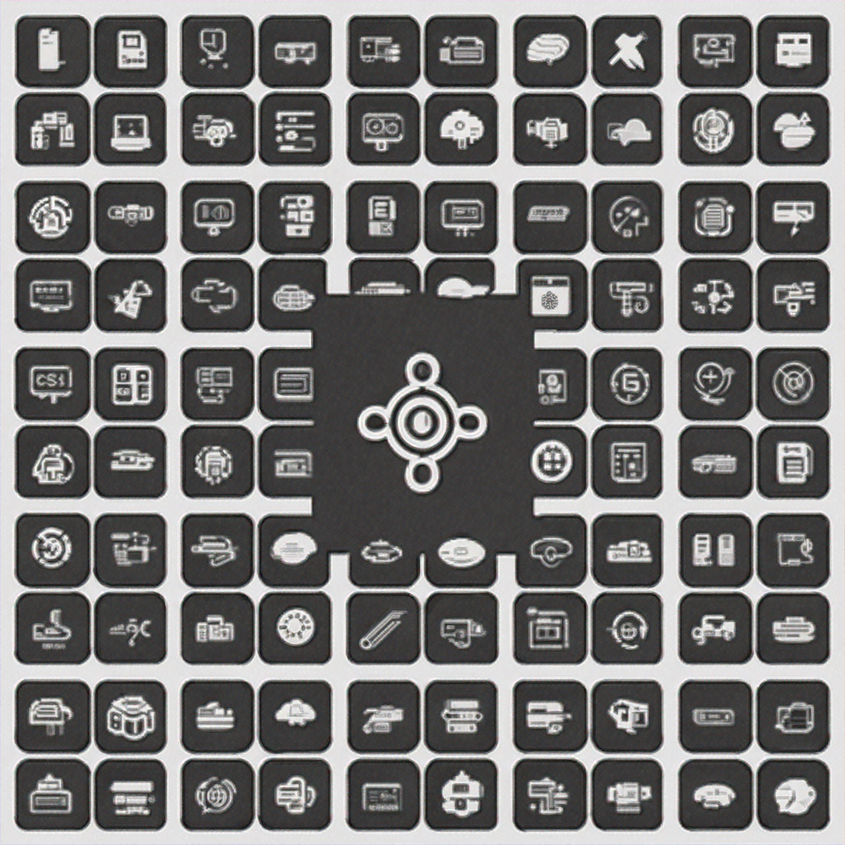


Where are we now?
What do we have?
System Components
Applications
Development Tools
Large Language Models
Diffusion Models
Embeddings Models
Chatbots
Customer Service Agents
Enterprise Knowledge
Pair Programming
Architecture Assistants
Notes:
What do we have now?
Throughout 2023, innovation in generative AI was significant. We have now gone well beyond simple chatbots, and we now have a range of different tools at our disposal, all powered by generative AI.
We start with the system components. These are the basic building blocks of all generative AI applications. We have large language models, which have been trained on vast quantities of text and are, as of this presentation, the cornerstone of the business and social value provided by generative AI. Diffusion models are used for generating images and videos. And finally, embedding models use the same base principle as large language models to represent data in embedding space, such that it can be used with sophisticated search algorithms.
The applications we are developing using generative AI are only scratching the surface of the technology's capability. Chatbots are still prevalent, as this is where the boom started, and they are still popular today. The use of chatbots as customer service agents is expanding, but we are also using techniques like retrieval-augmented generation to assist business users in getting access to vast libraries of enterprise knowledge.
And, of course, development tools. It is no surprise that the industry benefiting the most from generative AI is the IT industry itself and software development tools such as Amazon Q are increasing the efficiency of developers and business users alike.

Slide 5
Where are we now?
What can we build?
CREATE
THINK
LOOP
Generation
Reasoning & Planning
Iterative Execution
“Summarize the following report…”
“Write code that can…”
“…think though this step by step before generating your final answer.”
“You have access to the following tools…”
”Here is the response from the tool…”
Notes:
What can we build now? As we dive into these different technologies, there are a few key developments within the use of generative models that are pushing the boundaries of what this technology can do.
Basic generation is still the underpinning of everything we do currently with generative AI. The ability to generate text and images is the basis from which we derive model intelligence. Through careful prompting, we have discovered that these models are capable of reasoning and planning. Prompting techniques, such as "think through this step-by-step before generating your final answer," encourage capable generative models to "think" and plan a series of steps that can be taken to achieve complex tasks. This planning can then be coupled with agents, tools, and function-calling to reach out beyond the bounds of the model itself into the real world.
Iterative execution builds upon the idea that humans and other systems can interact and converse with models, to the point that models can converse with themselves. For example, a model that has reasoned and planned a solution may propose that solution, and then, after execution of the solution through tools, can respond to the output and make iterative improvements. This is especially relevant when models are generating quantifiably correct outputs, such as developing code. Models may generate code, run the code, look for defects, and fix the defects, all triggered from a single user-initiated prompt.

Slide 6


Where are we now?
What can the impact be?
The interface between user and data can be shortcut.
Writing code and building architectures can be accelerated through next generation of developer tools.
Notes:
What are the impacts now?
For decades, the challenge for software developers has been to connect users with data. Various technologies have been created to expedite this process with different programming languages and tools. Generative AI is now greatly influencing this space in two key ways. Firstly, by creating sophisticated, generic interfaces between users and data, without the need for tightly coupled applications. This is exemplified by the use of chatbots to interact with data, and to "chat with your documents." While we are still trying to find the best ways to integrate chatbots into day-to-day life, they are a great example of how the user-to-data connection can be shortcut.
In addition, generative AI-enabled developer tools also allow for the rapid development of applications that connect users to data. The slide image illustrates these two impacts. The left side shows a user interface with various data representations, suggesting that the interface between the user and data can be shortcut, likely through chatbots or conversational interfaces. The right side depicts a construction site with code in the foreground, indicating that writing code and building architectures can be accelerated through the next generation of developer tools powered by generative AI.

Slide 7
The skills of an AI Engineer (2024)
Agenda
Foundation Models & Model Selection
Prompting Engineering
Retrieval Augmented Generation (RAG)
Agents, Tools and Function Calling
Fine-tuning and Continuation training
Notes:
Agenda
In this presentation, we are going to cover a number of areas that are key to the AI engineer in 2024. Firstly, foundation, models, and model selection, then prompt engineering. (yes, this is still a thing in 2024), retrieval augmented generation (R. A. G.), agents, tools, and function, calling, and then finally find tuning in continuation training (although these are probably only done as a last resort).

Slide 8
Foundation Models & Model Selection

Slide 9







Foundation Models
+
+
Notes:
Foundation Models
- By the end of last year we had an established list of Foundation Models for a mixture of modalities. But still LLMs (text based models) reign supreme in regards to value.
- Multi-model models are starting to emerge. What will this mean? Much larger data sets, more capabilities. More emergent properties?
- Access to Foundation Models via API remains by far the most cost effective way to start working with Foundation Models.
– Vendors are abstracting away from the complexities of hosting and using models to enable developers to swap between models relatively easily.
- List some top foundation models.

Slide 10
Model Selection
Text & Vision
Image
Embedding
Text
Modality
API
Tasks
Server
Reasoning
Hosting
Capability
?
Chat
Local
Customize
Cost
Speed
Cost/Token
Token/Sec
Infra
Streaming
Notes:
Foundation Models
This diagram aims to help with the process of selecting a model, which is appropriate for your use case. There are a number of key decision points to be made, including hosting (where are you want, where you need, the model to be hosted). Modality. (what kind of data will you use to prompt the model, and what kind of data do you want out from the model). Capability (this is usually determined by the size of the model and can also be seen as “intelligence” and will come at a trade-off with speed and cost). Speed (for models that are working directly with and users. For example, in a chat bot, the time to 1st token can be really important, and the ability of the model to stream the output, is also important. However, for some use cases speed is less important for example, when batch processing is being carried out.) Cost (this will always be a key non-functional requirement of any project. It’s important to understand the way that models are costed - for example cost per token – and our cost can be optimized.)

Slide 11
Prompt Engineering

Slide 12
Prompt Engineering
oui
yes
Text generation
Text summarization
Translation
Sentiment
analysis
More …
Notes:
Prompt Engineering
Let’s cover prompt engineering. This came to prominence at the very beginning of 2023 is it became clear that how we communicated to large language models (in particular) made a significant difference to the output, and the loudest to generate different kinds of tasks. Simple tasks, such as text generation and text summarization. And then more complex tasks, such as translation and sentiment analysis.

Slide 13
Prompt Engineering
“
Summarise the text between the <text></text> XML tags:
<text>
The 2024 letter to shareholders is…
</text>
”
In context learning
Notes:
Prompt Engineering
It turns out that a lot of working with large language models (and generative AI models in general) has a lot to do with text manipulation. If we can work with text strings, by inserting text into a temp late, and by extracting text out from a generation, we can achieve most things with generative AI.
Without needing to find tune or retrain models in anyway, we can work on our own data by using In Context learning. And while this is a sophisticated sounding term, it means nothing more than adding our own text into a prompt temp late before sending it to the model.

Slide 14
Prompt Engineering
“
You are a personal assistant. You are friendly, polite and casual. You help with…
”
“
You are a classifying agent that filters user inputs into categories. Your job is to sort these inputs before they are passed along to our function calling agent. The purpose of our function calling agent is to call functions in order to answer user's questions.
”
Notes:
Prompt Engineering
In addition to this, and I think this is one of the most exciting things ☺, we have moved into a time where we are using natural language to “persuade” a computer system (in this case, a generative AI model), to perform the task we want. We are moving away from curly brackets, numbers and programming languages, and now simply persuading models to do what we want. Here we can see real examples of the beginnings of prompts where we infuse character and sentiment to the large language model before I carried out our task.

Slide 15
Prompt Engineering
“
The user input is between the <question></question> XML tags:
<question>
What is the weather in Oslo right now?
</question>
”
Notes:
Prompt Engineering
But prompt and prompt engineering alone will only get us so far. What happens when we prompt a model as we can see in the slide.

Slide 16
Agents, Tools & Function Calling

Slide 17
Agents
What is the weather in Oslo right now?
Answer: As of 12:00 PM (noon) local time in Oslo, Norway, the current weather conditions are:
* Temperature: 4°C (39°F)
* Humidity: 84%
* Wind: Northwest at 12 km/h (7 mph)
* Conditions: Overcast with light rain showers
Foundation models have a learning cut off.
LLMs will “hallucinate” if given the chance.
What do we want from an LLM?
World knowledge…
Up to up…
Down is down…
The sky is blue…
Llama 2 Chat 13B
Notes:
Foundation models are trained on vast quantities of data, but they have a learning cut-off. That is to say, there is a limit to the currency of the knowledge that they have. Unfortunately, without taking precautions, it is common for large language models to hallucinate, that is to say, make up plausible-sounding answers to questions they are asked.
There are various techniques for combating hallucinations. The first is to ensure that fine-tuning of the model is done in such a way as to discourage the model from hallucinating, in other words, to successfully know when the model doesn't know something.
Another technique, and arguably the best technique, is to not rely solely on the knowledge within a large language model to answer specific questions. We should ask ourselves what we truly want from a large language model. My contention is that we want world knowledge, we want the model to understand fundamental concepts like "up is up," "down is down," and "the sky is blue." But we don't want the model to know specific factual information, such as who was the president of a certain country on a certain date. This latter kind of factual information should be easily attainable from a database. Perhaps the ability we most want from a large language model is its capability to understand language, frame a problem, and then access the answer from an authoritative system.
Take this example: "What is the weather in Oslo right now?" In this case, the model has hallucinated an answer based on its general understanding that it is often cold in Oslo, but it has no factual information and no way to know the actual current weather in Oslo.
The slide image illustrates this concept. The question "What is the weather in Oslo right now?" is asked, and the model provides a detailed response with temperature, humidity, wind, and conditions. However, this response is marked as "Llama 2 Chat 13B," suggesting that it is a hallucinated response from the model rather than an accurate, up-to-date weather report retrieved from an authoritative source. This was not fair on Llama2, but it serves as illustration of the issues! ☺

Slide 18
Agents
Give LLM applications tools.
agency.
agents.
agency
/ˈeɪdʒ(ə)nsi/
2. action or intervention producing a particular effect.
Notes:
To solve this problem, and to give the large language model the ability to connect to external systems, we can use agents. By giving the model access to agents, we give it agency in other words, the ability to interact with the outside world.

Slide 19
Agents
Agent
Request Data
LLM Application
User /
Consumer
Agent
Retrieve Data
Agent
Trigger Events
Notes:
In this architecture, we can see the connections between a large language model, the incoming requests from a user or a consumer, and then the models connection to a number of different agents that are able to interact with the outside world.

Slide 20
Agents
What is the weather in Oslo right now?
Demo time…
Notes:
So what is the weather in Oslo right now?

Slide 21

Agents
What is the weather in Oslo right now?
(Preview)
Notes:
In this Sample code, you will use agents for Amazon, bedrock to connect with a Weather service, location, service, and the time of day to be able to answer the question “what is the weather in Oslo right now” and much more.

Slide 22
Retrieval Augmented Generation (RAG)

Slide 23
Retrieval Augmented Generation
Agent
Request Data
LLM Application
User /
Consumer
Agent
Retrieve Data
Agent
Trigger Events
Notes:
One common a agent workflow which gained a great deal attraction towards the latter half of 2024 was retrieval augmented generation (R A.G). This workflow specifically connects to authoritative data sources to help the large language model powered application, truthfully, answer questions.

Slide 24
Retrieval Augmented Generation
LLM Application
Vector Database
User /
Consumer
Agent
Your data
Notes:
Whilst not, the only way I’ve performing retriever look meant to generation, the most commonly discussed method is to use a vector database. In this architecture, your data (documents) are stored in a vector database and used to augment the generation from the model. (Cast your mind back to in context learning, this is a more sophisticated implementation of exactly the same thing.)

Slide 25
Retrieval Augmented Generation
LLM Application
Vector Database
User /
Consumer
Agent
Embedding Model != LLM
Agent responds with text.
Does not require a vector DB.
Embedding Model
Your data
Notes:
In order to load your data into a vector database, we convert the data to embeddings using a special model called an embedding model. It's important to realize that this embedding model is not the same as a large language model, even though it may share some architectural similarities.
The user makes a request of a large language model application asking for a specific piece of information, for example, "What is the capital city of Australia?"
This question gets combined with a prompt template, which explains to the large language model that it has the ability to source data from an agent, in this case, text information from the vector database.
The large language model generates an output which includes instructions for the surrounding application to interact with the agent and to make a call to the vector database to retrieve information that relates to the query, in this case, geographic and maybe political information about certain countries.
The vector database performs a similarity search, using a query that was provided by the large language model to find all relevant articles, documents, or portions of documents that relate to the query being made.
These documents, or parts of documents, are passed back through the agent to the large language model, and the large language model combines that information with its understanding of natural language, looking for the specific answer to the question that was asked.
The large language model can then extract relevant information, formulate a natural language response, and send that back to the user.
The slide image illustrates this process of Retrieval Augmented Generation. The user or consumer interacts with the LLM Application (Large Language Model Application). The LLM Application communicates with the Agent, which in turn interacts with the Vector Database. The data (articles, documents) is converted to embeddings using an Embedding Model, separate from the LLM, and stored in the Vector Database for similarity searches. The key points are: the Embedding Model is distinct from the LLM, the Agent responds with text, and this process does not require a vector database for the LLM to generate responses, but it enhances the quality of responses by retrieving relevant information from the Vector Database.

Slide 26


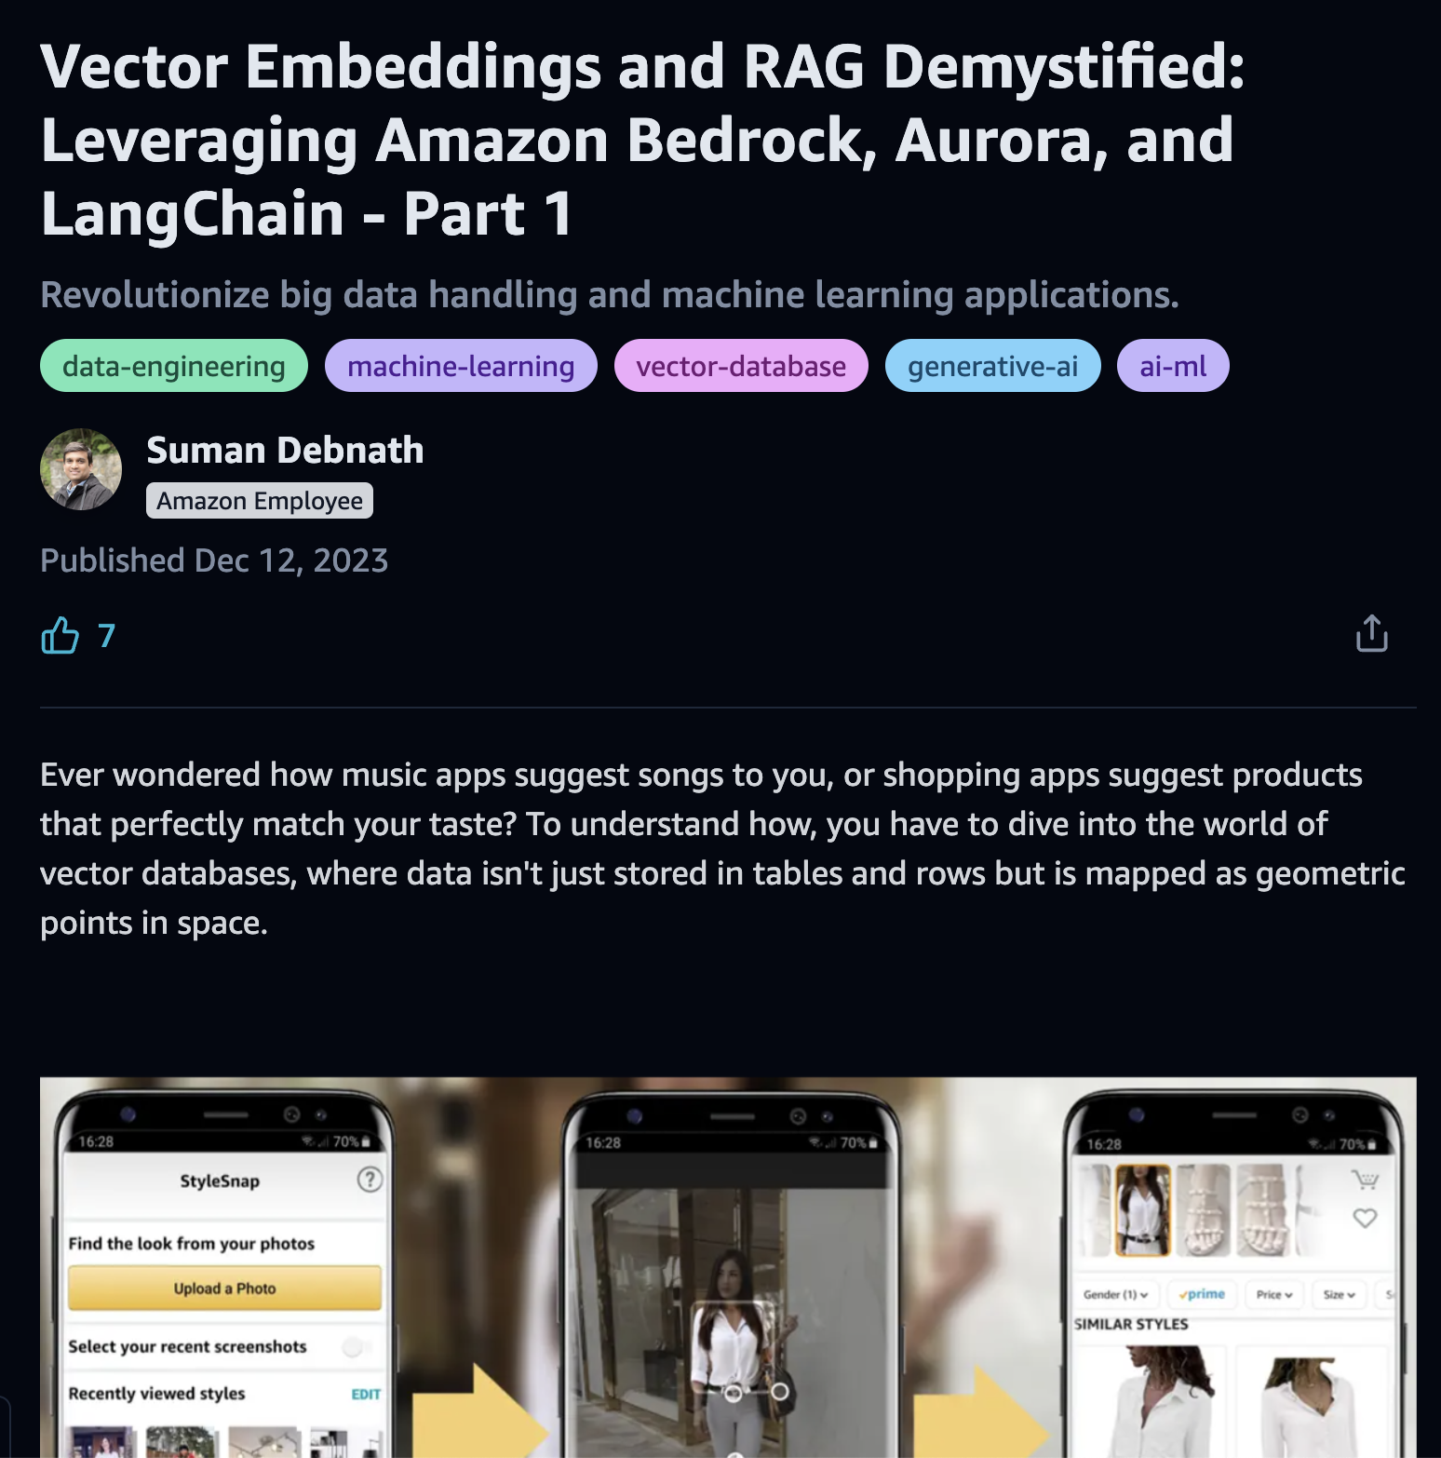
Retrieval Augmented Generation
COMMUNITY
Notes:
For more in-depth information on factor, databases retrieval augmented generation, and how these can be implemented, take a look at this article.

Slide 27
Fine-tuning and Continuation training
“I have experimented with different models and different prompts, and I am not getting the generation I want.”
“Gather some examples and provide them to the model.
You can do this in the prompt with in-context-learning…
Or if you have enough, you can fine-tune the model.”
Notes:
Finally, let's discuss fine-tuning and continuation training. These techniques should be considered as a last resort after trying prompt engineering, contextual learning, retrieval-augmented generation, and agents.
If, after experimenting with these approaches, we are still unable to get the desired information or style of generation from a model, then we might start to look at fine-tuning and continuation training.
If we have tried different models and prompts, and we are still not getting the desired generation, then we can gather examples and provide those examples of the kind of generation we want back to the model through a process called fine-tuning.
Fine-tuning gives us the ability to adjust the way models behave in response to various prompts. With fine-tuning data, we provide examples of many different prompts and the corresponding desired generations for those prompts. Using modern fine-tuning techniques (although more costly than prompt engineering), we can adjust the way large language models behave.
Continuation training is another technique that can be used to further refine the model's behavior. In continuation training, the model is exposed to additional training data that is similar to the desired output, allowing it to continue learning and improving its generation capabilities in a specific domain or style.
It's important to note that fine-tuning and continuation training should be considered after exhausting other, less resource-intensive methods, such as prompt engineering and retrieval-augmented generation. These techniques can be more computationally expensive and may require more specialized knowledge and resources.

Slide 28
Fine-tuning and Continuation training
“I work in a specialized field, and the model does not seem to understand the terminology we use.”
“Gather as much domain specific example text that you can, and perform continuation training on the model.”
Notes:
However, if we work in a specialized field and find that the large language model is not aware of the specific language that we use in our industry, then we may turn to continuation training.
The name suggests continuation training is a continuation of the training of the model, using the same or similar methods used by the original creators of the foundation model. This includes updating all of the parameters inside the model and therefore is costly and time-consuming.

Slide 29

Share your feedback about the session and generative AI services
1 min Community Survey
Notes:
Dear speaker: we would really appreciate if you keep this slide and get attendees to answer it. It takes less than 1 minute, and it will help us a lot support the community better and addressing their feedback.
Thanks a lot.
AWS Community team

